Slide 1

Nexial Automation test automation platform for everyone
http://nexiality.github.io

Slide 2
Agenda
Introduction
Why Nexial; What Nexial can and cannot do
Getting Started: Installation
Getting Started: Anatomy of a Nexial project
Getting Started: tools and utilities
Commands I: base, number, external, step, sound
Built-in Functions
Nexial Interactive / Inspection
Iterations
Commands II: io, excel, csv, json, xml
Nexial Expression
System Variables
Macro
Organizing your test artifact
Publish test result
Execution dashboard
Event notification
Notes:
Nexial Workshop Series
Session 1
Introduction
Why Nexial; What is Nexial; How does Nexial work
What Nexial can and cannot do
Installation: JDK, Nexial, and “Hello World” the Nexial Way (/w Labs)
Update Nexial the easy way
Anatomy of Nexial project
Understanding data file, test script, test plan, macros, project.properties
Nexial tools/utilities (stuff under bin/) (/w Labs)
Walkthrough: Command I (/w Labs)
base, number, step, sound
Session 2
Topic: Troubleshooting (Inspection, Nexial Interactive) (/w Labs)
Walkthrough: Command II (/w Labs)
io, excel, csv, json, xml, ssh
Walkthrough: Built-in Functions (/w Labs)
Walkthrough: Nexial Expression (/w Labs)
Walkthrough: Macro (/w Labs)
Walkthrough: Flow Control / Nexial Filter (/w Labs)
Walkthrough: Loops (/w Labs)
Topic: Organizing your test artifact
Topic: Publish test result
Topic: Execution dashboard
Topic: Event notification (/w Labs)
Session 3
Topic: API testing (/w Labs)
Setup
Testing against HTTP verbs
HTTP header
JSON payload / JSONPath
XML payload / XPath
Basic / OAuth automation
Session 4
Topic: Database testing (/w Labs)
Setup
Testing with CRUD
Query metadata
Comparing output
Transaction support
Automation through external file
Bulk SQL generation via “template”
Session 5
Topic: Web testing (/w Labs)
Interacting with Browser
Locators
Cross-browser Automation / BrowserStack / Headless
Frame/IFrame
JavaScript testing
Cookie Manipulation
Alert / Confirm and Prompt
Bring Your Questions / Feature Requests / Script Review / Anything Goes

Slide 3

Introduction
Started late 2016 as an internal project at EP
First known as Sentry
Aimed to provide automation enablement for non-programmer
Initial focus on desktop and web automation
Opensource in March 2018
https://github.com/nexiality/nexial-core (give us a Star!)
Under Apache License 2.0
Download: https://github.com/nexiality/nexial-core/releases
(EP) http://bit.ly/nexial-distro

Slide 4






Introduction: Beyond Conventional Expectation
functional
Req. Analysis / Sprint Grooming
Test Design
Test Execution
Defect Resolution
Automation Design
Functional Test Engineer
Test Automation Engineer
Manager
Functional Test Engineer
automation
Defect Resolution
Automation Execution
Script Development
Observe/Support
Manager
Test Automation Engineer
performance
Perf. Requirement
Script Development
Env. Readiness
Perf. Test Execution
Perf. Result Publishing
Performance Test Engineer

Slide 5
Introduction: Scaling Beyond Expectation
Converging People, Process, Technology
functional & automation
Business & Perf. Req. / Sprint Grooming
Test Design
Test Execution / Automation
Defect Resolution
CoE: consists of process guidance and support, and automation engineers to enhance and maintain framework/toolset.
All projects: QA as the “automation user” or the user of the framework to support all aspects of testing – Quality Engineer
Quality Engineer
Observe/Support
Defect Resolution
Regression Automation
Manager
performance
Env. Readiness
Test Design & Execution
Result Publishing
CoE Support

Slide 6
Why Nexial: Strategy and Focus
Strategy: Effectiveness and Efficiency
Automation Platform for Everyone!
No programming knowledge required, but can integrate with other scripts
Ability to automate a wide array of interfaces and systems
Support regression, integration and exploratory (interactive mode) testing
Integration with existing toolset (JIRA, Jenkins, etc.)
Cohesion Across Quality Activities
Collaboration and Integration as 1st forethought
Scripts and toolset reuse amongst various testing
Improve Efficiency
Engage BA, UAT testers and offshore resources early
Blurring the lines between manual, automation and performance testing
Optimizing the convergence of People, Process and Technology
Focus: Quality Engineer as First Class Citizen

Slide 7
Why Nexial: Quality Engineer as 1st Class Citizen
Automation ≠ Coding
Hybrid/Scriptless approach means no or very little coding required for automation
Simple/consistent approach to maintain/execute tests
Framework supports external data management and generation
Framework supports local and remote testing; CI ready
Automation > Coding
Get more done via declarative extension and imports
Framework support multiple interfaces (Web, Desktop, Batch, etc.) and multiple types of testing (functional, regression, performance and E2E)
Integration with enterprise tooling
Reinforce Best Practice and Process
Focus on Quality and Software Testing
Agility practitioners (reusability, integration, collaboration)

Slide 8
Nexial: Core Features
Automation scripting from Excel
Support multiple application architecture
Web, desktop client, API, service, DB
Support functional, regression, E2E, perf. testing
Execute locally and remotely / CI Integration
Consistent execution reporting
Integrate with external exec (exe, bat, sh) and test framework (JUnit)
Portable test artifact management
Data management

Slide 9







Nexial: Overview
I/O and file-type automation
api, soap, http automation
tax reports
browser automation (all major browsers)
Quality Engineer
test plan/script/data
desktop automation (windows only)
database automation (all major RDBMS)
batch & remote automation

Slide 10


Nexial: Integrating Across Sprints and Projects
Release-bound test execution
[ smoke / performance / E2E ]
Sprint-bound test execution
[ functional / regression / CI ]
reuse of test cases across projects
improve coverage and confidence
Project A
Project C
Smoke Testing
Test Case 1
Test Case 5
Test Case 1
Test Case 6
Test Case 2
Test Case 6
Test Case 3
Test Case 7
collaborate existing tests
Project B
Test Case 7
manage & execute tests
Test Case 4
Test Case 9
Performance Testing
Test Case 3
Test Case 8
Test Case 1
Test Case 5
Test Case 9
collaborate existing tests
Test Case 4
Project D
Test Case 2
Test Case 6
Test Case 10
Test Case 9
Engineers
collaborate existing tests
Test Case 3
Test Case 8
Test Case 11
Test Case 10
E2E Testing
Test Case 11
Test Case 1
Test Case 5
Test Case 9
review test cases & results
Test Case 2
Test Case 6
Test Case 10
Test Case 3
Test Case 7
Test Case 11
UAT Testers / Product Owners
Test Case 4
Test Case 8

Slide 11
Nexial: What it does not do
Record-and-Play
Drag-n-Drop Designer
Code Coverage and Instrumentation
Full-featured Debugger
Some debugging capabilities available today
More will be added in future

Slide 12
Getting Started: Installation
https://nexiality.github.io/documentation/userguide/InstallingNexial
Install Java 1.8+ (64bit)
Support for Java 10, Java 11 and Corretto
Install Excel 2007 or above
.xlsx extension, NOT .xls
Latest version of Excel/Office supported
Install Nexial
All are encouraged to install/update to latest Nexial distribution
Nexial Installer (https://github.com/nexiality/nexial-installer)
(EP) http://bit.ly/nexial-installer
Install Browsers
Nexial supports recent versions of Chrome, Edge, Firefox, IE, Safari

Slide 13
Lab 1
Install Nexial via nexial-installer
Windows:
Download latest Nexial installer from http://bit.ly/nexial-installer
Unzip the installer (.zip) to C:\projects\nexial-installer.
Execute installer.cmd (Windows).
Latest Nexial is now installed to C:\projects\nexial-core.
More Info: https://github.com/nexiality/nexial-installer#usage
*NIX/Mac:
Download latest Nexial installer from http://bit.ly/nexial-installer
Unzip the installer (.zip) to ~/projects/nexial-installer.
Execute installer.sh.
Latest Nexial is now installed to ~/projects/nexial-core (*NIX/Mac).
More Info: https://github.com/nexiality/nexial-installer#usage
Run "Hello World" example

Slide 14
Getting Started: Anatomy of a Nexial project
https://nexiality.github.io/documentation/userguide/UnderstandingExcelTemplates
https://nexiality.github.io/documentation/userguide/UnderstandingProjectStructure
On Windows
C:\projects\
+-- PROJECT_NAME\
+-- .meta\
| +-- project.id
+-- artifact\
| +-- bin\
| +-- data\
| +-- plan\
| +-- script\
| +-- project.properties
+-- output\
+-- RUN_ID.YYYYMMDD_HHMMSS\
| +-- captures\
| +-- logs\
| +-- EXEC_RESULT.xlsx
On Mac/*NIX
~/projects/
+-- PROJECT_NAME/
+-- .meta/
| +-- project.id
+-- artifact/
| +-- bin/
| +-- data/
| +-- plan/
| +-- script/
| +-- project.properties
+-- output/
+-- RUN_ID.YYYYMMDD_HHMMSS/
| +-- captures/
| +-- logs/
| +-- EXEC_RESULT.xlsx

Slide 15
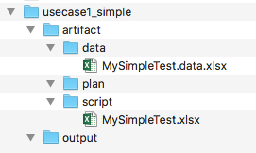
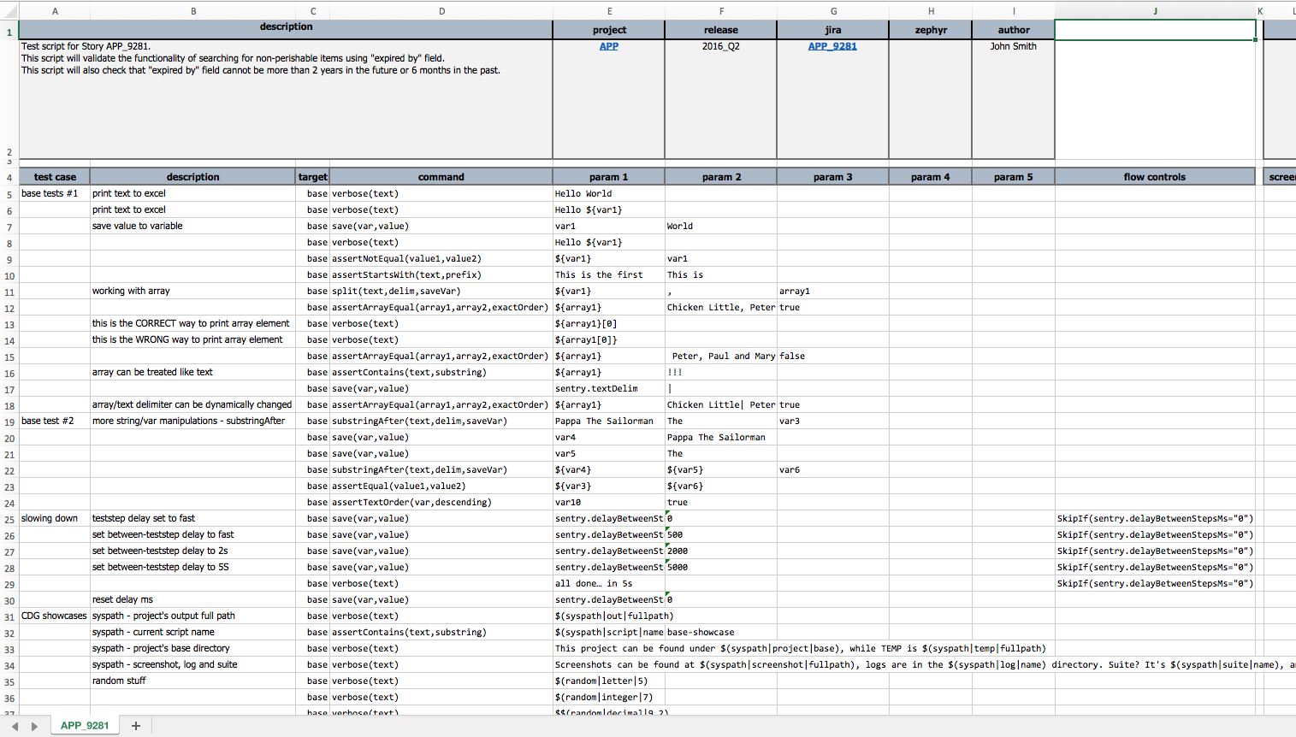

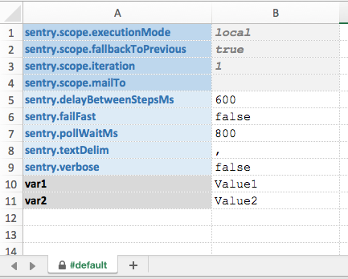
Getting Started: Anatomy of a Nexial project
Use Case #1: Simple / Single-Scenario Execution
… during script design/development
Nexial reads commands from Row 5 until a blank row (row without command) is found.
Nexial reads data from data sheet, from Row 1 until a blank row is reached.
Nexial, by default, reads scenario from left to right.
* Note: all sentry instances should be replaced with nexial.

Slide 16
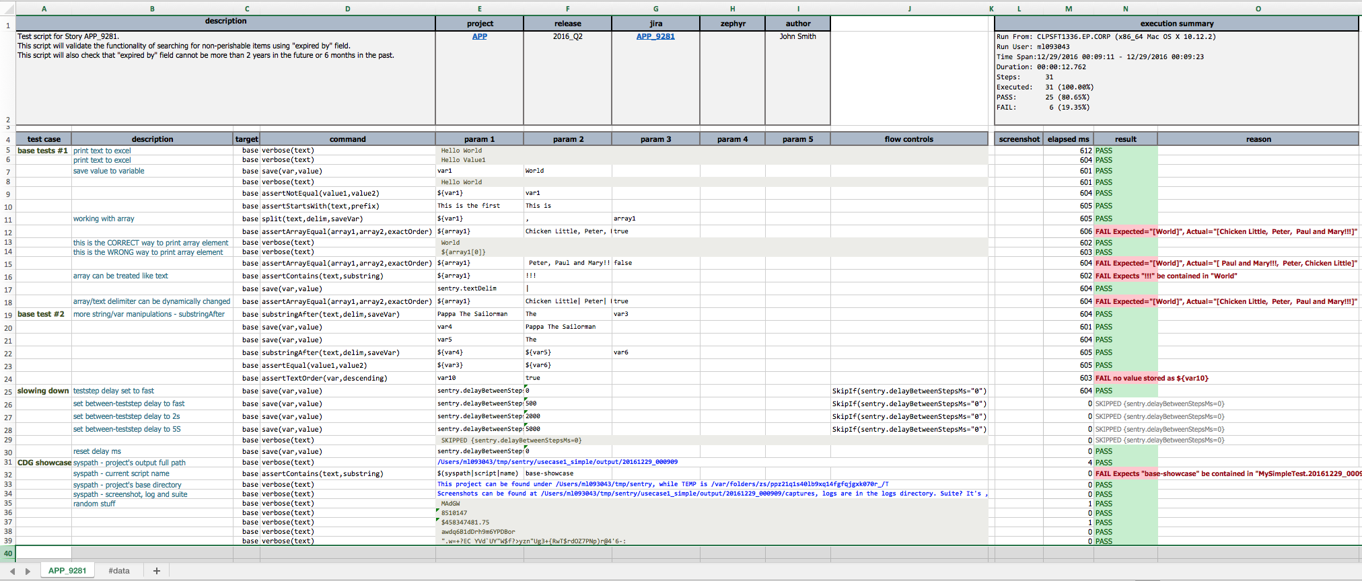
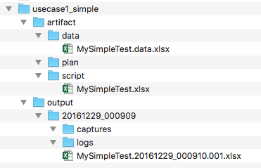
Getting Started: Anatomy of a Nexial project
Use Case #1: Simple / Single-Scenario Execution
… after script execution
execution result
#data sheet contains the “merged” data set for the execution
Naming convention: [test script].[execution start date/time].[iteration].xlsx

Slide 17
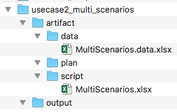
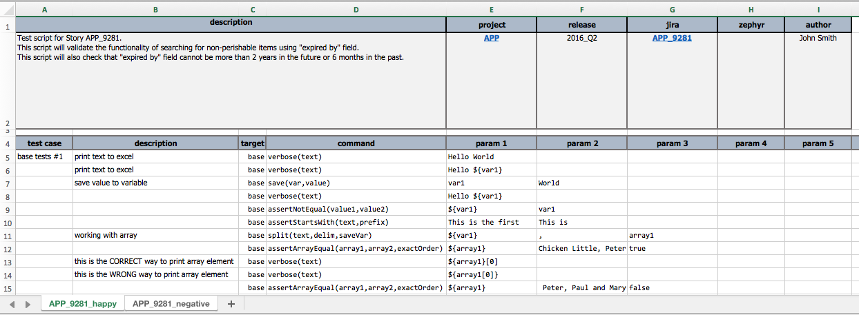
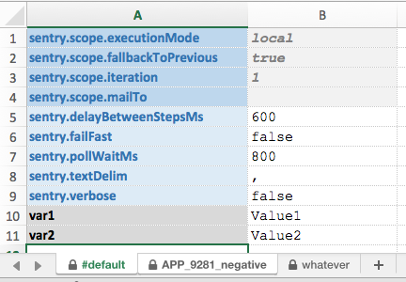
Getting Started: Anatomy of a Nexial project
Use Case #2: Multi-Scenario Execution
… during script design/development
Both APP_9281_negative and #default will be used when executing APP_9281_negative scenario
Only #default will be used since no APP_9281_happy datasheet exists
Not used; ignored

Slide 18
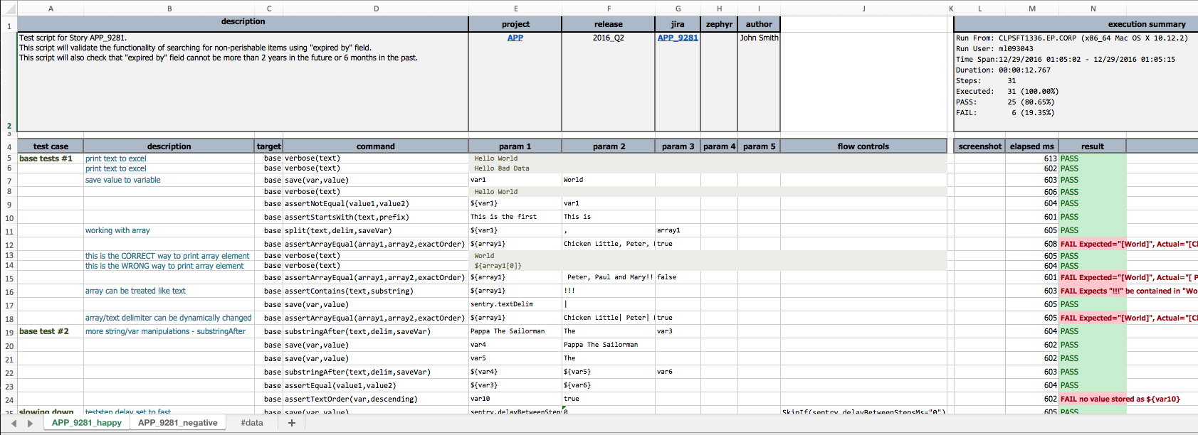
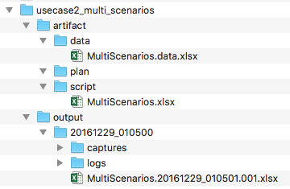
Getting Started: Anatomy of a Nexial project
Use Case #2: Multi-Scenario Execution
… after script execution
Each scenario has separate execution result
#data sheet contains “merged” data set from #default and APP_9281_negative datasheet from MultiScenarios.data.xlsx. MERGE ORDER: #default, APP_9281_negative. Last one wins.
By default, execution order of scenarios is left to right

Slide 19
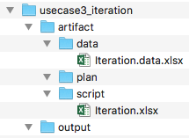
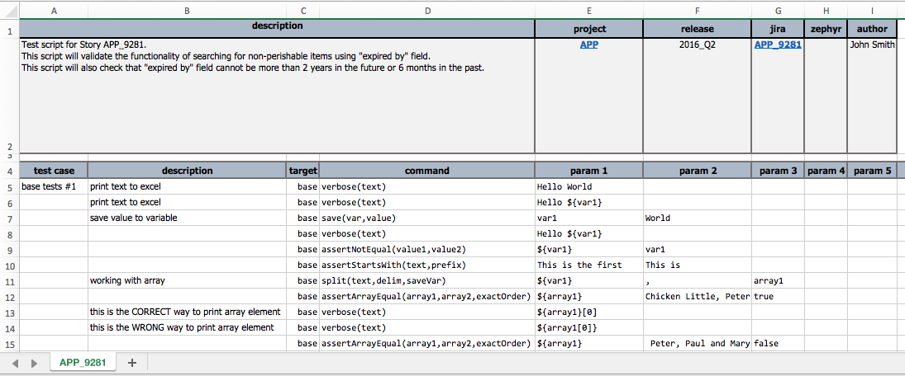
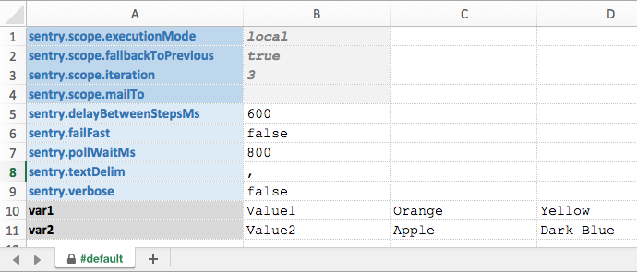
Getting Started: Anatomy of a Nexial project
Use Case #3: Iteration
… during script design/development
Key data elements for iteration testing
Each column represents a successive iteration for the same data element (i.e. var1, var2)

Slide 20
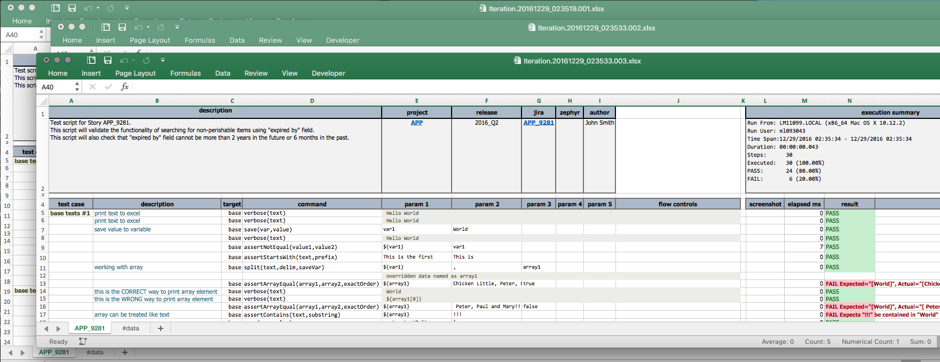
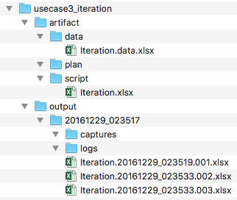
Getting Started: Anatomy of a Nexial project
Use Case #3: Iteration
… after script execution
Each iteration generates a separate output
result are tracked separately per iteration

Slide 21
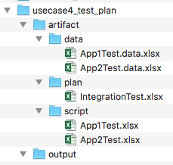
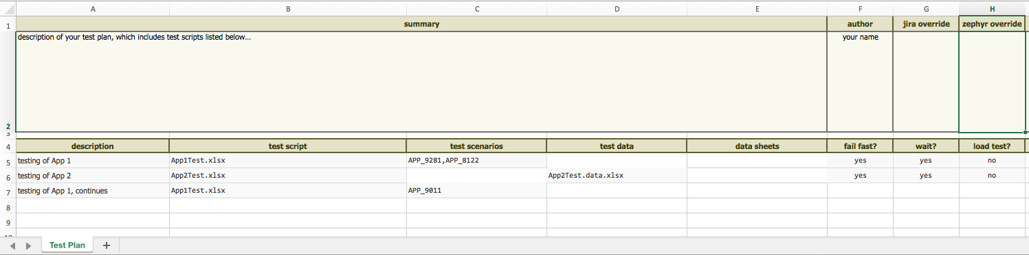
Getting Started: Anatomy of a Nexial project
Use Case #4: Test Plan
… during script design/development
App1Test.data.xlsx and datasheets matching specified scenarios are assumed
All scenarios will be executed (left to right)

Slide 22
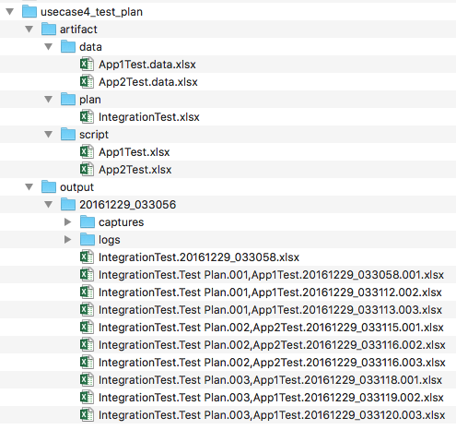
Getting Started: Anatomy of a Nexial project
Use Case #4: Test Plan
… after script execution
Naming convention: [plan file].[start date/time].xlsx
Naming convention: [plan file].[plan].[sequence],[test script].[start date/time].[iteration].xlsx

Slide 23
Getting Started: tools and utilities
https://nexiality.github.io/documentation/userguide/BatchFiles
From ${NEXIAL_HOME}/bin:
nexial-project.cmd, nexial-project.sh – creates new nexial-project.
nexial.cmd, nexial.sh – executes Nexial scripts or plans.
nexial-script-update.cmd, nexial-script-update.sh – updates test scripts with the latest available commands.
nexial-crypt.cmd, nexial-crypt.sh – encrypts the sensitive data.
nexial-setup.cmd, nexial-setup.sh – sets up user/env. specific configurations.
nexial-variable-update.cmd, nexial-variable-update.sh – uniformizes data variables across test artifacts and projects.
nexial-macro-update.cmd, nexial-macro-update.sh – refactor macro declaration and use across test artifacts.
nexial-desktop-xpath-update.cmd, nexial-desktop-xpath-update.sh – optimizes XPath(s) used for desktop automation (application.json).
nexial-log-parser.cmd, nexial-log-parser.sh – captures elapsed time of given steps from execution logs.

Slide 24
Lab 2
nexial-project
Windows: nexial-project.cmd [PROJECT_NAME | C:\projects\PROJECT_NAME] [TEST FILE] [TEST FILE 2] … …
*NIX/Mac: ./nexial-project.sh [PROJECT_NAME | ~/projects/PROJECT_NAME] [TEST FILE] [TEST FILE 2] … …
Try re-running this script on existing project; Try running this script on non-standard project location
nexial-crypt
Windows: nexial-crypt.cmd [PLAIN TEXT]
*NIX/Mac: ./nexial-crypt.sh [PLAIN TEXT]
What if we want to encrypt text with spaces or pipes? How are encrypted data represented in logs and output?
nexial-script-update
Windows: nexial-script-update.cmd -t [%PROJECT_HOME%\artifact\script]
*NIX/Mac: ./nexial-script-update.sh -t [$PROJECT_HOME/artifact/script]
What if we want to update multiple projects?
nexial-variable-update
Windows: nexial-variable-update.cmd -t [%PROJECT_HOME%\artifact] -d [var1=var2;var3=var4]
*NIX/Mac: ./nexial-variable-update.sh -t [$PROJECT_HOME/artifact] -d [var1=var2;var3=var4]
What about text files, SQL files or JSON files with old data variables? What if I want to review the changes before committing to it?
nexial
Windows: nexial.cmd –script [SCRIPT FILE]
*NIX/Mac: ./nexial.sh –script [SCRIPT FILE]
What other options are available? How can I run a script with different data files or data sheets? What about test plan?

Slide 25
Command: base
Nexial's Concept of "Command"
Action
Validation
Basic and Rudimentary commands – base
In many cases, Nexial treats data as "text".
Many of the text-related commands are provided in this command type.
Nexial has facilities to transform "text" to other types like LIST, NUMBER, JSON, XML, etc., and vice versa.
Reference:
https://nexiality.github.io/documentation/commands/base/

Slide 26
Command: number
Numerical operations
increment, decrement, average, min, max, floor, ceiling
Numerical assertions
equals, greater, greater-or-equal, lesser, lesser-or-equal, between
More numerical support via built-in functions and expression
https://nexiality.github.io/documentation/expressions/NUMBERexpression
https://nexiality.github.io/documentation/functions/$(count)

Slide 27
Lab 3
Basic Execution (base, number, step)
Data Variable Overwrites
Think about:
What's the difference between the assertEqual() command from base and number?
How to use a datasheet that is different than that of scenario?
Can we use multiple datasheets while specifying a single scenario?
How to clear data variables?
How to check if a data variable is defined (or exist)?
How does Nexial represent invalid data variable?
How to mingle automated test steps with manual ones?

Slide 28
Lab 4
Working with List
Make Nexial sing and talk
Nexial as your Messenger
Think about:
What are some good use cases for the sound commands?
When will the sound commands NOT work?
How can Nexial play a sound or audio file of my choosing?
What are some effective ways to generate [large] dynamic content?
How do I generate a list of numbers? What if the numbers are in the form of xxx,xxx,xxx.xx?

Slide 29
Built-in Functions
Functions – in-place (inline) common automation routines
Syntax: $(…|…|…)
$(array): data extract and operations
$(count): count matching characters of specific type from text
$(date): date format and operation
$(execution): extract metadata from current execution
$(file): extract file metadata and perform file operations
$(format): textual formatting to represent various data types
$(projectfile): retrieve project-bound file content
$(random): randomizing numerical and character content
$(sysdate): exposing date/time information of current test harness
$(syspath): exposing file name and path information of current execution

Slide 30
Lab 5
Functions
Think about:
How to express date/time as timestamp (millisecond expressed as integer)?
How to format date/time as day of the week?
How to sort the content of a file?
How to select an item from a list?

Slide 31
Execution-Time Inspection
Pause execution for runtime inspection of data and expressions.
Set nexial.inspectOnPause as true.
Add PauseAfter() or PauseBefore() flow control to desired step.
Inspection supports:
Data variables: ${…}
Built-in functions: $(…)
Nexial Expression: [TYPE(…) => …]
Useful when combined with other System variables:
Set nexial.pauseOnError as true.
Set nexial.stepByStep as true.

Slide 32
Nexial Interactive
Execute in Interactive Mode:
Allow reloading of script, data file and project.properties file.
Reassigning of script, data file, scenario, iteration.
Execution a portion of the script (either by activity or by steps).
Re-execute steps in or out of order.
Inspection supported in Interactive Mode.
Useful for:
Learning Nexial or new Nexial features
Learning Test Automation
Learning existing scripts
Learning (possibly new) target application
Exploratory Testing

Slide 33
Lab 6
Work on the questions in Lab 5
Use Nexial Interactive and Inspection to help learn new Nexial features and test out your scripts
Think about:
What Nexial features would not work in Nexial Interactive?

Slide 34
Iteration
Iteration with Data Augmentation
Add data column-wise in datasheets.
Executing the same script/scenario/activity with different data set.
Remember "last one win" rule: iteration with multiple datasheet could be confusing.
How to:
Add nexial.scope.iteration to specify desired number of iterations.
Add nexial.scope.fallbackToPrevious to allow data reuse from previous iteration.
Think about:
How to keep each execution structurally consistent, but with some variations?
How to iteration out of sequence?
How to generate iteration-aware data and execution?
Notes:
Regex online tool: https://regexr.com/

Slide 35
Flow Control
https://nexiality.github.io/documentation/flowcontrols/
Stepwise directive to control the flow of the execution
For example,
"Pause immediately after this step is executed" – PauseAfter() or PauseAfter(true)
"Execute this step only when amount is greater than 1000" – ProceedIf( ${amount} > 1000)
"Stop execution if there are more than 15 errors" – EndIf( ${nexial.executionFailCount} > 15 )
"Skip this step for the first iteration" – SkipIf( ${nexial.scope.currentIteration} = 1 )
Conditions expressed as Nexial Filter (next page).
Useful to create execution variance without create new scripts/scenarios.
Create more dynamic execution paths for possibly greater coverage.
Documentation
Notes:
Regex online tool: https://regexr.com/

Slide 36
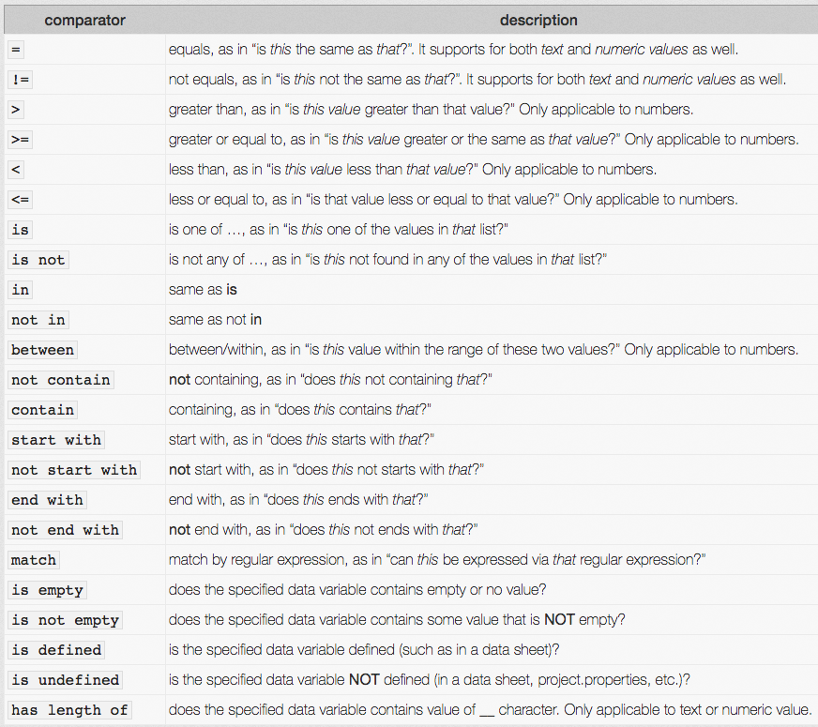
Nexial Filter
https://nexiality.github.io/documentation/flowcontrols/filter
Express a single or combined (AND) conditions
Used mainly in Flow Control and Expression.
Support for text, numeric and list data types.
Syntax: [subject] [comparator] [controls] & [subject] [comparator] [controls] …
Notes:
Regex online tool: https://regexr.com/
Lab-07 / scenario1
Lab-07 / scenario2

Slide 37
Iteration through Repeat-Until
https://nexiality.github.io/documentation/commands/base/repeatUntil(steps,maxWaitMs)
Iteration with specialized command: base » repeatUntil(steps,maxWaitMs)
Embed iteration within one scenario. One scenario can have multiple repeat-until loops.
Control the number of steps within one iteration.
Control the maximum time allow to complete the entire loop (think SLA).
Can be used in combination with Iteration.
Think about:
How would the step result in each iteration be presented?
How to break out of a loop prematurely?
How to skip over a specific iteration?
How is this better or worse than Iteration?
Notes:
Regex online tool: https://regexr.com/
Lab-07 / scenario3

Slide 38
Iteration Comparison
Iteration
Data managed in datasheet
Number of Iteration managed in datasheet
Separate execution output per iteration
Can be used in combination with repeat-until loops
Can use Flow Control to create execution variance
"Last one wins" rule can be confusing
No easy way to repeat iteration
Takes more time
Repeat-Until Loop
No special data management; can read from datasheet or create on-the-fly
Number of loop managed by first-step check
No dedicated execution output per loop
Can be used in combination with Iteration
Can use Flow Control to create execution variance
No special rules for data loading / overrides
Easier to skip or repeat loop
Generally faster
Generally use to represent a complete process, workflow or transaction
Usually requires an external logging strategy to harvest in-iteration execution result
Notes:
Regex online tool: https://regexr.com/

Slide 39
Lab 7
Iteration and Repeat-Until
Use Iteration to read through a series of files
Use Repeat-Until loop to do the same
Think about:
Which approach is faster? What is sacrificed at the cost of speed?
What are the advantages and disadvantages of using either approach?
How to overcome of some of the shortcomings in each approach?
What are the telltale sign(s) that favor one approach over the other?

Slide 40
Command: io
https://nexiality.github.io/documentation/commands/io/
Basic CSV automation
assert*
base64(var,file)
make/copy/rename/move/delete/list*
read/write*
compare(expected,actual,failFast)
saveDiff(var,expected,actual)
validate(var,profile,inputFile)
searchAndReplace(file,config,saveAs)
zip/unzip
Additional capabilities via Nexial Expression

Slide 41
Command: excel
https://nexiality.github.io/documentation/commands/excel/
Commands to automate basic Excel features
saveRange(), saveData()
write(), writeVar(), writeAcross(), writeDown()
clear()
setPassword(), clearPassword(), assertPassword()
csv(), columnarCsv()
json()
Currently no automation on
Styling
Function
Charting
Cell Merging

Slide 42
Command: csv
https://nexiality.github.io/documentation/commands/csv/
Basic CSV automation
compare(expected,actual,failFast)
compareExtended(var,profile,expected,actual)
convertExcel(excel,worksheet,csvFile)
fromExcel(excel,worksheet,csvFile)
More capabilities via Nexial Expression
https://nexiality.github.io/documentation/expressions/CSVexpression

Slide 43
Command: json
https://nexiality.github.io/documentation/commands/json/
Available JSON commands
addOrReplace(json,jsonpath,input,var)
assert correctness, wellformed, element present, element count, value(s)…
store value(s), count…
Utilize Nexial JsonPath to reference one or more nodes within JSON doc.
https://nexiality.github.io/documentation/jsonpath/index
Simple notations, but not suitable for very complex structure. No function support.
More capabilities via Nexial Expression
https://nexiality.github.io/documentation/expressions/JSONexpression

Slide 44
Command: xml
https://nexiality.github.io/documentation/commands/xml/
Available XML commands:
assert correctness, wellformed, elements, value(s)…
store value(s), count
Uses standard XPath 2
https://www.webtoolkitonline.com/xml-xpath-tester.html
http://xpather.com/
More capabilities via Nexial Expression
https://nexiality.github.io/documentation/expressions/XMLexpression

Slide 45
Lab 8
IO / Excel / JSON / XML commands
Some Nexial Expressions as well
Think about:
What are the difference between excel » saveData(), excel » saveRange() and [EXCEL(file) => read(…) save(…)]?
How to extract byte values off a file content?
How to forcefully stop execution only if an error occurs within a "critical" section (block of steps)?

Slide 46
Nexial Expression
https://nexiality.github.io/documentation/expressions/
Express data type specific operations
Type-aware transformations and operations.
Operation chaining.
Interoperable with data variables and built-in functions.
Concise, efficient resource utilization, maintainability, possibly simpler.
Syntax:
[TYPE(data) => op(params) op(params) …]

Slide 47
System Variables
https://nexiality.github.io/documentation/systemvars/
Predefined configurations:
Control Nexial behavior during execution.
Expose system-level information/metadata.
Mostly prefixed with nexial.
Many of the Java runtime environment variables are also exposed
Prefixed with java., os., user.
Think about:
Which System Variable can throttle the speed of my execution?
Which System Variable can I use to make OS-specific execution?
Which System Variable will terminate my execution after x number of FAIL's?

Slide 48
Macros
https://nexiality.github.io/documentation/commands/base/macro(file,sheet,name)
Collect a well-defined set of test steps as an reusable sequence.
Improve reusability (best combined with a common data strategy).
Improve readability
Improve control
Macros are stored in a "macro" file
Copy from ${NEXIAL_HOME}/template/nexial-macro.xlsx
Macro file can contain multiple macros.
Each worksheet is considered as a "library".
Referenced by its file, worksheet and macro name.

Slide 49
Lab 9
Rewrite Lab 6
Rewrite Lab 7
Think about:
What are the prep work towards effective use of macros?
How to organize macros?
How to create "global" macro libraries?

Slide 50
Organizing Test Artifact
Activity
What's considered as an "Activity"?
When to break up an activity?
How many activities in a scenario is considered too many? What are the drawbacks?
Scenario
What's scenario synonymous to? What's the logical difference between "scenario" and "activity"?
What's an ideal number of scenarios in one script?
Data
Where to store test data – and why? #default sheet, scenario-specific sheets, project.properties, at command line…
External data
SQL, JSON, XML, etc.
Where to store them?
General
Effective way to name plans, scripts, scenarios, activities
Effective way to manage (think source code management) your test artifacts

Slide 51
Publish Test Result
Use nexial.runID.prefix
Name it so that you can find it later!
Use nexial.outputToCloud
Nexial Execution Dashboard
https://nexiality.github.io/documentation/userguide/ExecutionDashboard
Time Tracking
https://nexiality.github.io/documentation/flowcontrols/timeTracking.html
Measure time differences between 2 arbitrary steps

Slide 52
Event Notification
https://nexiality.github.io/documentation/userguide/EventNotification
Ability to notify when specific event occurred during execution
Notification: sms, email, sound, console (with pause), tts
Generate dynamic and contextual content as part of notification
Conditional Notification
Use Nexial Filter to further control event notification

